Slide 1
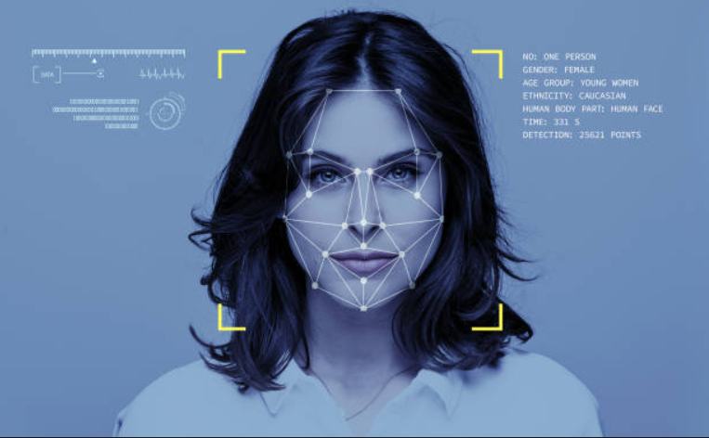
EMOTION RECOGNITION BY INCLUSION OF AGE AND GENDER PARAMETER BY DEEP LEARNING
Project Guide : Ms Joylin Priya Pinto
Asst .Prof GD-1
Depart of computer science Nitte Karkala
PRESENTED BY
Aditya Murugan
Akil Raif Ashwamedh Arote Adithya Holla k
4nm19cs010 4nm19cs014 4nm19cs031 4nm19cs007

Slide 2
Problem Definition
1
2
Literature Survey
3
CONTENT
System Specifications
4
System Design
5
Screen Shorts of Output
6
Conclusion And Future Work

Slide 3
The main motive is to develop an age ,emotion and gender estimation method towards human faces which will continue to possess an important role in computer vision and pattern recognition.
Apart from age estimation, facial emotion recognition also plays an important role in computer vision.
This implementation proposes a new framework of Convolutional Neural Network for the simultaneous tasks of age estimation, gender recognition and emotion recognition on face images.
PROBLEM DEFINITION

Slide 4
LITERATURE SURVEY
LITERATURE PAPER
ABSTRACT
Detection of Gender, Age and Emotion of a Human Image using Facial Features
The main motive is to develop an automatic age and gender estimation method towards human faces which will continue to possess an important role in computer vision and pattern recognition. Apart from age estimation, facial emotion recognition also plays an important role in computer vision. Non-verbal communication methods such as facial expressions, eye movement and gestures are used in many applications of human computer interaction. In order to create computer modeling of humans age, gender and emotions a plenty of research has been accomplished.
04

Slide 5
LITERATURE SURVEY
LITERATURE PAPER
ABSTRACT
Facial emotion recognition using deep learning: review and insights
Automatic emotion recognition based on facial expression is an interesting research field, which has presented and applied in several areas such as safety, health and in human machine interfaces. Researchers in this field are interested in developing techniques to interpret, code facial expressions and extract these features in order to have a better prediction by computer. With the remarkable success of deep learning, the different types of architectures of this technique are exploited to achieve a better performance. The purpose of this paper is to make a study on recent works on automatic facial emotion recognition FER via deep learning.
05

Slide 6
LITERATURE SURVEY
LITERATURE PAPER
ABSTRACT
Age, Gender Prediction and Emotion recognition using Convolutional Neural Network
Automated age and gender detection has been generally used in our daily lives that we come across, majorly in a person to computer interaction, visual surveillance, biometric analysis, electronics and other applications of commercial use. By recognizing the emotions of a person, we can improve the recommendation system. The existing methods have quite satisfying performance on real-world images if facial expressions of input image is neutral or calm, it lacks significantly in age prediction when facial expressions are altered. An improvement in the performance of these tasks was observed by using the convolutional neural-nets (CNN).The accuracy of the wide- resnet model is 96.26% and for the emotion recognition model, accuracy achieved is 69.2%.
06

Slide 7
SYSTEM SPECIFICATIONS
HARDWARE REQUIREMENTS
SOFTWARE REQUIREMENTS
CPU Intel Pentium 2 or higher. 2.Cores Minimum dual core.
Memory 8 GB or higher.
Hard Disk space 100 GB or higher
Pandas And Numpy Keras
TensorFlow SeaBorn
07

Slide 8
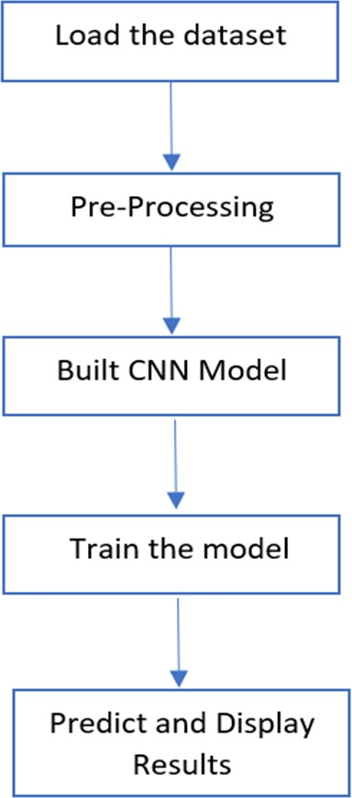
SYSTEM DESIGN
08

Slide 9
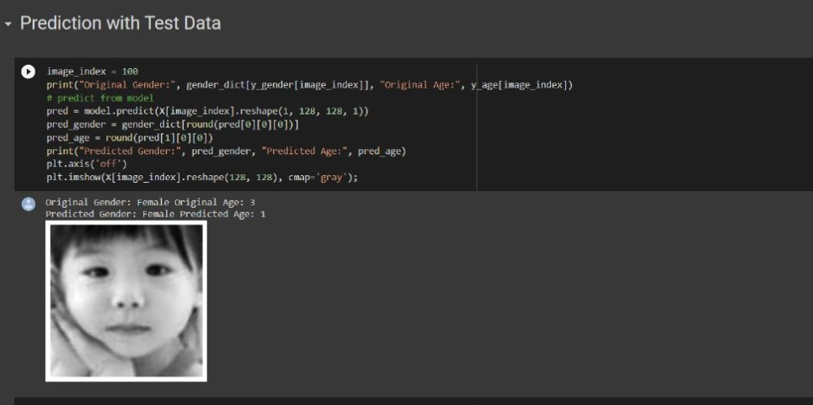
OUTPUT

Slide 10
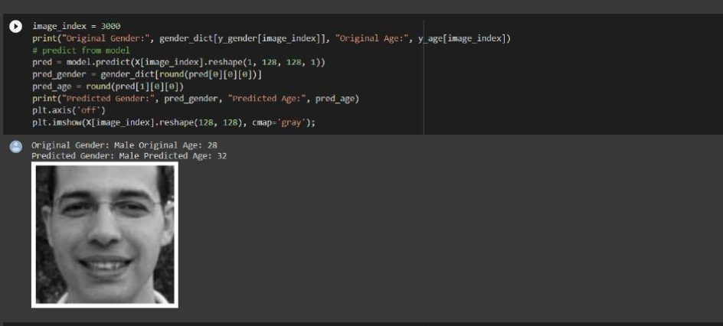
OUTPUT

Slide 11
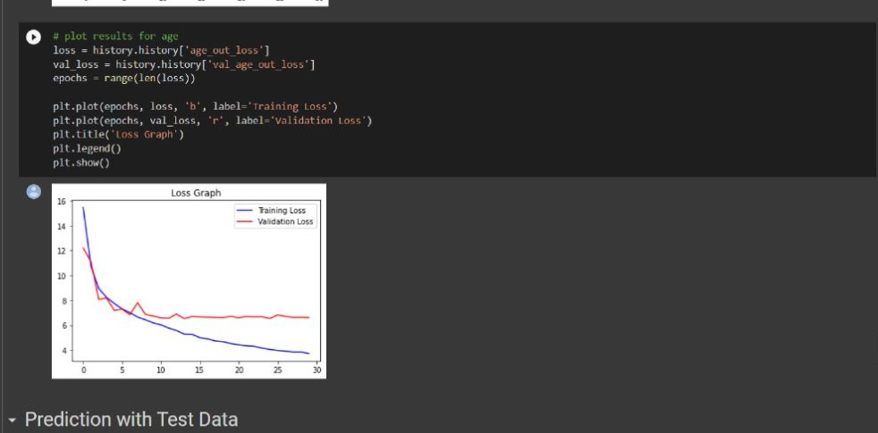
OUTPUT

Slide 12
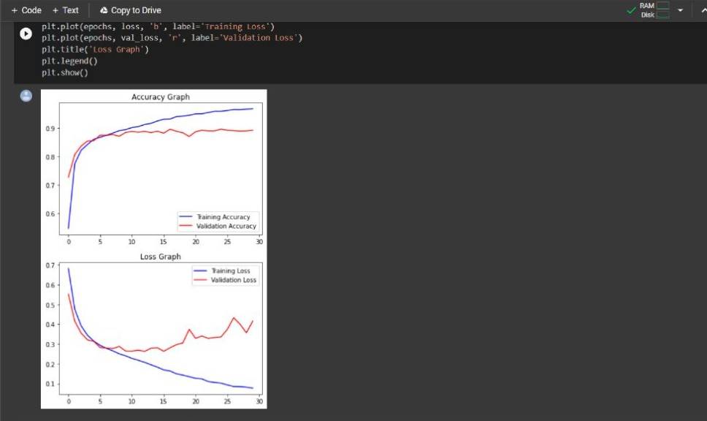
OUTPUT

Slide 13
The proposed framework is capable of emotion recognition, age estimation and gender
T
recognition simultaneously in a fast and efficient way.
Misclassifications might occur because people from different ethnic groups have different facial characters, which might slightly alter the actual age from the predicted age. The use of glasses might affect the emotion classification by interfering with the
CONCLUSION AND FUTURE WORK
features learned.
Finally, it would be interesting to implement this model on a live business service. This project can be applied in social media to customize advertisements and content, in e- commerce to customize product listing and in entertainment industry to customize OTT (over the top) content.

